Slide 1


Twitter Sentiment Analysis
Meenakshi Shankara
DSC680 – Bellevue university
Summer 2023

Slide 2



Agenda
Introduction
Data
Modeling
Takeaways
Next Steps
References

Slide 3




What is Twitter Sentiment Analysis?
Sentiment analysis is the automatic process of classifying text data according to their polarity, such as positive, negative and neutral.
A Twitter sentiment analysis identifies negative, positive, or neutral emotions within the text of a tweet. It is a text analysis using natural language processing (NLP) and machine learning.

Slide 4

Data
Data Dictionary
There are four columns in each dataset.
Tweet ID – a unique tweet ID - Numeric
Entity – product/service mention in tweet - String
Sentiment – vibe of the message - String
Tweet text – the content of the tweet - String
The training dataset has 74682 records
The validation dataset has 1000 records.

Slide 5
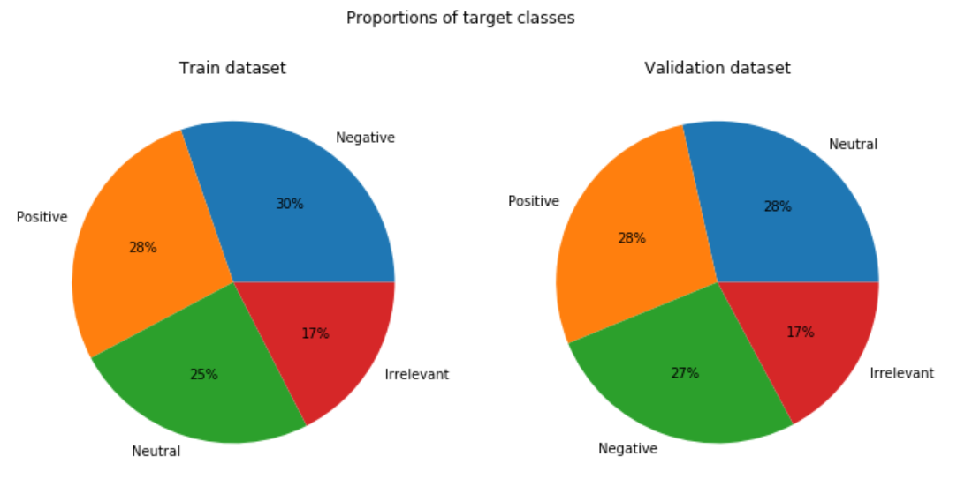
Visualizations
Training vs Validation datasets
Target value distribution is similar
almost ~40-45% values are either neutral or irrelevant.

Slide 6
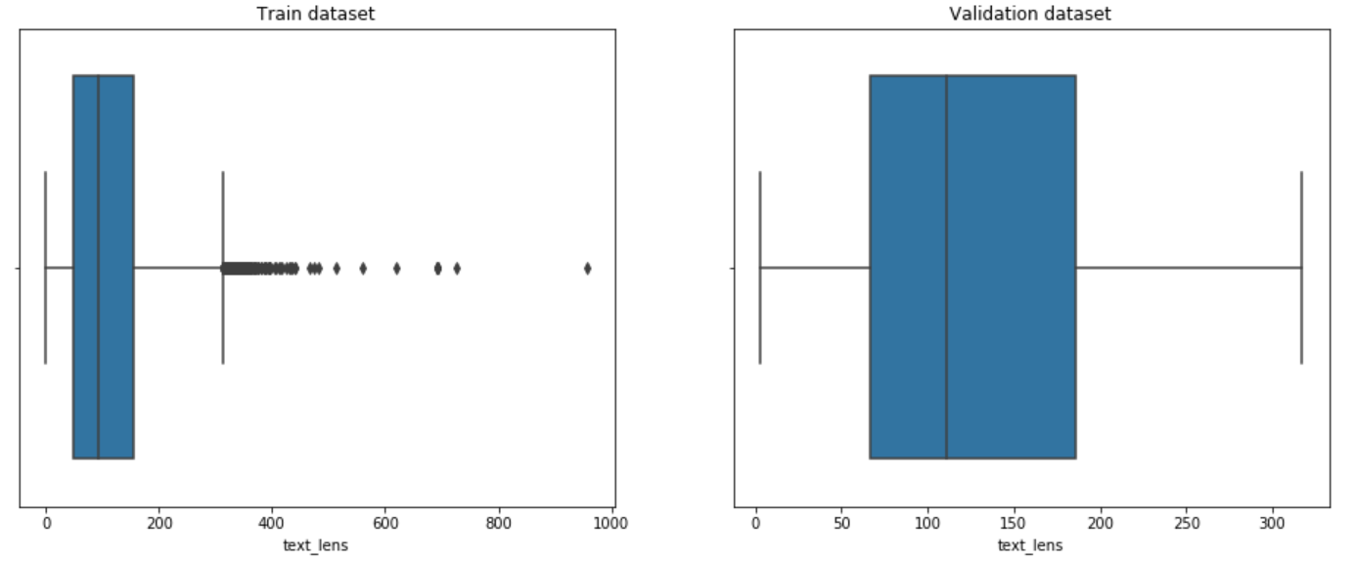
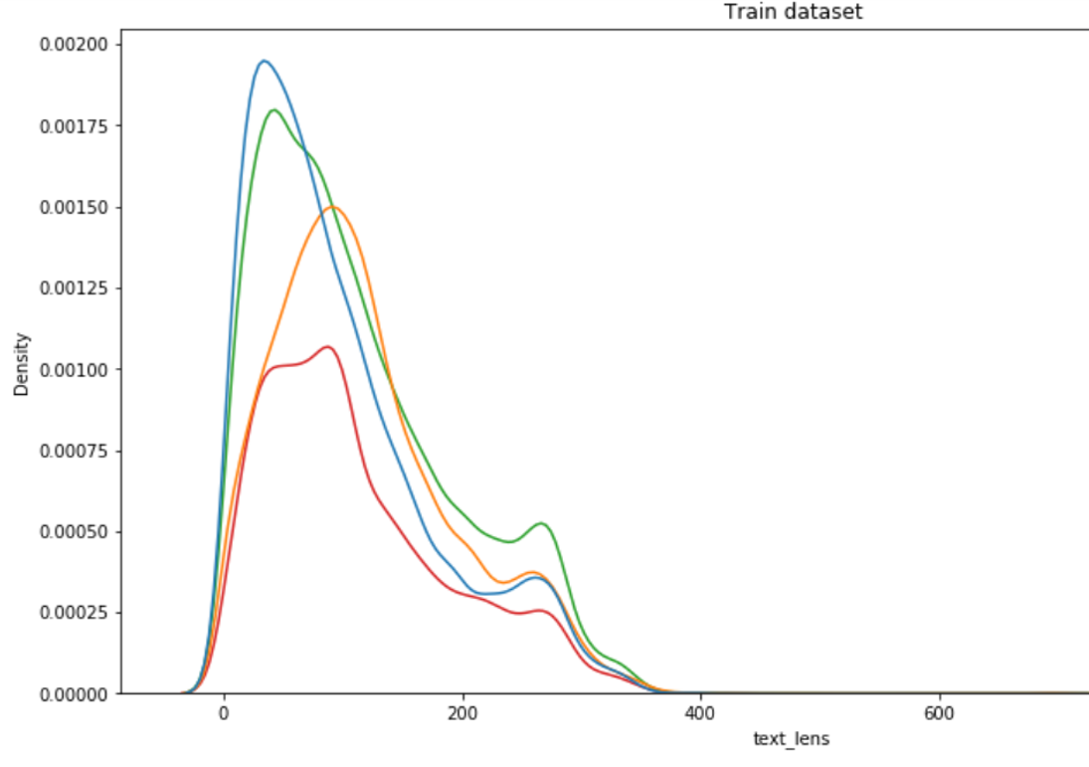
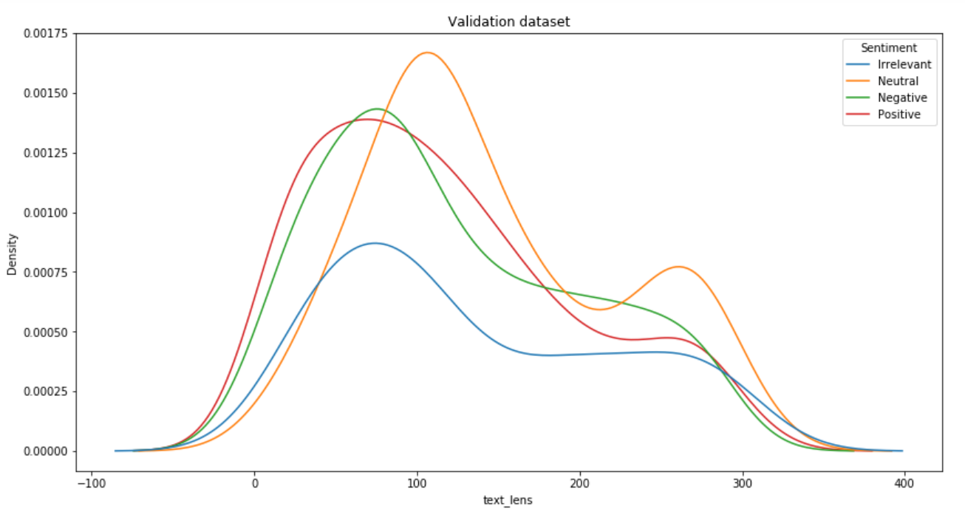
Visualizations – Tweet Length
Text lengths of most tweets fall between 0-200 in both the Train and Validation datasets.
The full range is similar as well, 0-400.
Training dataset has a few outliers that fall outside of length 400.

Slide 7
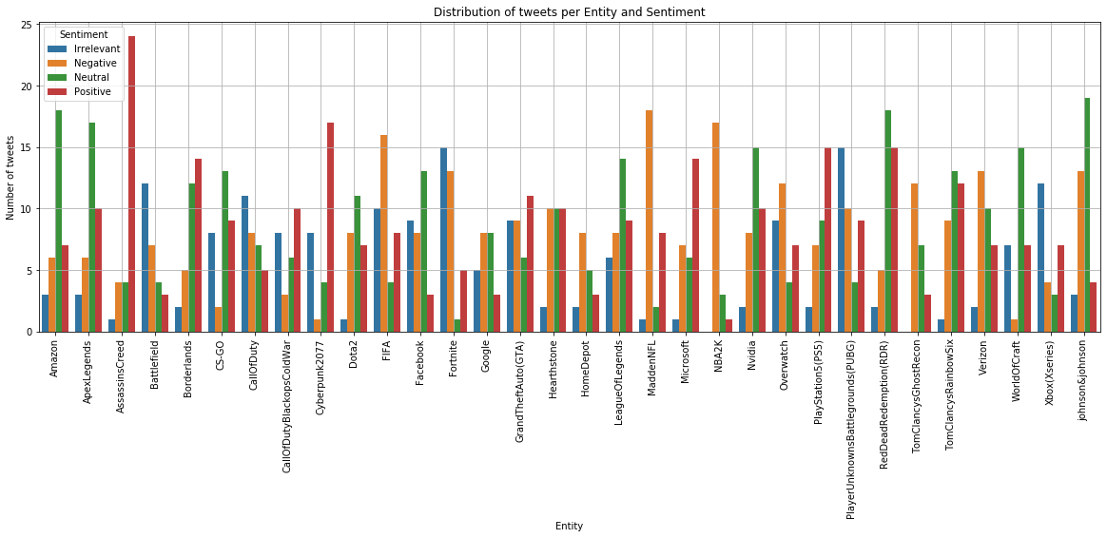
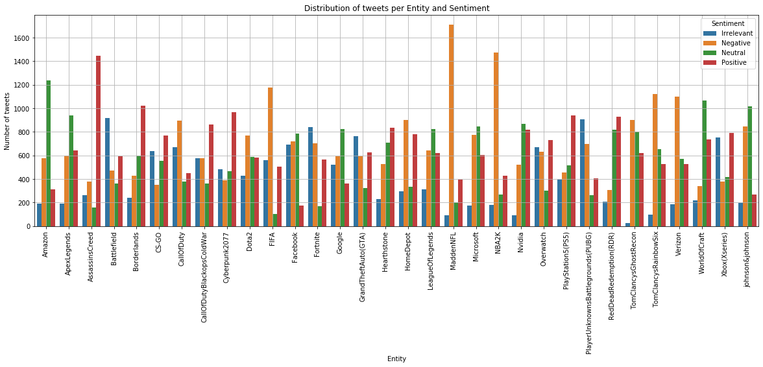
Distribution of sentiments for each Brand/Entity. - the distribution of sentiments for each entity is similar in both the datasets. - trend of sentiments in both the datasets is also similar - Madden NFL has the most negative sentiments and Assassins Creed has the most positive sentiments in both the datasets.
Visualization – Sentiment Distribution

Slide 8

Data Modeling
Text tokenization technique –
Bag of Words with
ngram = 1 and ngram = 4
Modeling Algorithms -
Logistic Regression
Random Forest Classifier
Decision Tree Classifier
Multinomial Naive Bayes

Slide 9
Key Takeaways
Bag of Words Ngram = 1 | Dataset | Precision | Recall | F1-Score | Accuracy
Model
Logistic Regression | Train | 0.84 | 0.84 | 0.84 | 83.65%
 | Validation | 0.94 | 0.94 | 0.94 | 93.60% | √
Random Forest | Train | 0.91 | 0.91 | 0.91 | 91.00%
 | Validation | 0.96 | 0.96 | 0.96 | 95.70% | √
MultinomialNB | Train | 0.76 | 0.75 | 0.75 | 75.01%
 | Validation | 0.83 | 0.82 | 0.82 | 81.90%
Decision Tree | Train | 0.83 | 0.82 | 0.82 | 82.93%
 | Validation | 0.9 | 0.9 | 0.9 | 90.20%
Data fitting on Bag of words ngram=1 –
Random Forest performed the best with 95.7%
Logistic Regression models at 93.6%
Data fitting on Bag of words ngram= 4
Logistic Regression is at 98.6% accuracy score
MultinomialNB is at 97.6% accuracy
Bag of Words Ngram = 4 | Dataset | Precision | Recall | F1-Score | Accuracy
Model
Logistic Regression | Train | 0.92 | 0.91 | 0.91 | 91.43%
 | Validation | 0.99 | 0.99 | 0.99 | 98.80% | √
Random Forest | Train | 0.9 | 0.9 | 0.89 | 89.57%
 | Validation | 0.96 | 0.96 | 0.96 | 96.40%
MultinomialNB | Train | 0.92 | 0.92 | 0.92 | 91.66%
 | Validation | 0.98 | 0.98 | 0.98 | 97.60% | √
Decision Tree | Train | 0.77 | 0.77 | 0.77 | 77.32%
 | Validation | 0.9 | 0.9 | 0.9 | 90.20%
From the various model results we find Logistic Regression and Random Forest to be stable candidates for building models for our analysis.
Further analysis to refine the modeling solution to be done for MultinomialNB.

Slide 10
Assumptions, Challenges, Limitations
Assumptions
Limitations
target values in the datasets correctly represent the sentiment of the tweet
null values and duplicate records were not significant
Limited records of ~71k for training and 1k for validation
Target values already set based on manual interpretation
Challenges
Decisions on data cleansing leading to insufficient data for modeling
Technical challenges –
conversion of emoticons to text,
translation of non-English text to English.

Slide 11

Next Steps
Implementation Plan - The models Logistic Regression, Random Forest regression, and Multinomial NB can be implemented for predicting the sentiment of the tweets with very good results.
Recommendations – Analyze the models with different tokenizing techniques and with real-world data to find a better performing model.
Ethical assessments –
1. No PII Data has been used for the analysis
2. All data sources are extracted from public domains, shared by organizations for educational purposes
3. All references are listed

Slide 12
Ethical assessments –
1. No PII Data has been used for the analysis
2. All data sources are extracted from public domains, shared by organizations for educational purposes
3. All references are listed below
References –
Twitter Sentiment Analysis | Kaggle
Logistic Regression Optimization & Parameters | HolyPython.com
Twitter Sentiment Analysis With Python | Introduction & Techniques (analyticsvidhya.com)
How to Interpret the Classification Report in sklearn (With Example) - Statology

